Slide 1


Slide 2
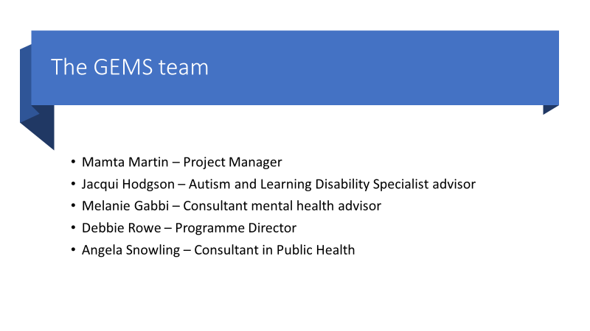
The GEMS team

Slide 3
Who is GEMS for?
GEMS is for children, young people and adults who are diagnosed with, or who may have, autism and/or attention deficit hyperactivity disorder (ADHD).
The service also supports parents and carers. Whatever stage of your autism/ADHD journey you are at – pre-assessment or post-diagnosis – GEMS offers a single point of contact where you can access information, advice and support.
GEMS is being delivered by Solutions 4 Health and is commissioned by NHS East Berkshire Clinical Commissioning Group and Bracknell Forest Council.
Solutions 4 Health is a CQC registered organisation and we are proud to be working with the NHS, hospitals, clinical commissioning groups, health boards and local authorities across the UK.

Slide 4
What do we provide?
Our interactive workshops, based on evidence-based programmes, are available weekdays, evenings and weekends, face to face and online.
For parents and carers, a programme of workshops
For children and young people aged 5-25, a programme of workshops and social groups
For adults aged 25+, a programme of workshops and social groups

Slide 5
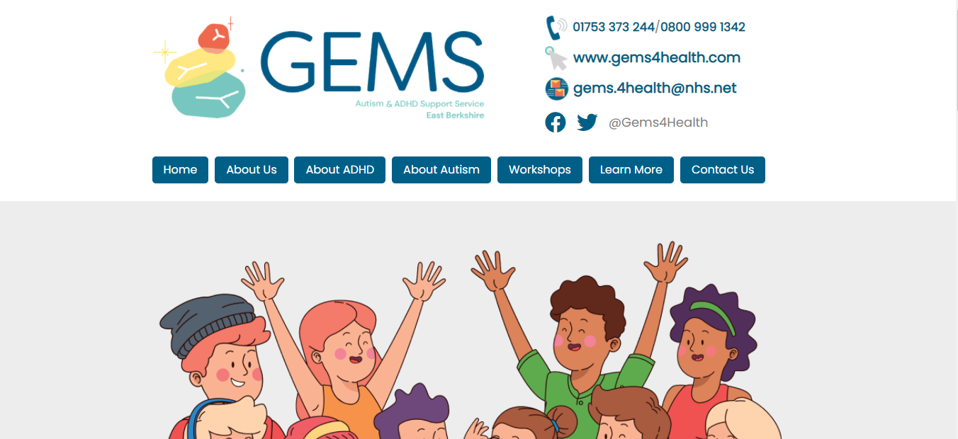
The GEMS website – currently for those aged 16+

Slide 6
Our helpline
The telephone helpline is intended to help with accessing the right kind of help and early support, for children and young people 0-25 who have Autism or ADHD based on their needs and is available to all in East Berkshire
Support offered: interactive workshops, Referral to support groups, with the purpose of improving quality of life for children, young people, parents/carers and families affected by autism and ADHD within East Berkshire
The helpline will be available between 0900 and 1700 hrs. each day.

Slide 7
Contacting our helpline
The helpline will Interpret enquiries and answers to carefully structured questions to determine the level of support needed
Recommend service users to an appropriate level of support or other services, health professionals, sources of information…
Service users will be signposted to organisations such as:
The autism group, Parenting special children,
National Autistic Society, Clear Autism and others…

Slide 8
Workshops provided by partners
The Autism Group – Single sessions covering the following topics; Girls and autism, High Anxiety, What about me, Adolescence and a telephone and home visit support service for those who are digitally excluded, have English as a second language or who have vision or hearing challenges.
Parenting Special Children – Single sessions covering Sleep and Sensory Processing and a three session pre and post ADHD support programme

Slide 9
Short online courses available 24/7
What is autism?
Navigating through services; autism from referral onwards
Communication and autism
Positive behaviour support
Sensory difficulties and autism
What is ADHD?
ADHD; navigating through the process from diagnosis to beyond
ADHD management via therapies
ADHD in the BAME community
Food and mood (in development)

