Slide 1


The ZONES of Regulation®

Slide 2
What is it?
The Zones of Regulation is an internationally-renowned intervention which helps children to manage difficult emotions, known as ‘self-regulation’.
It provides children strategies to help them cope with and understand many feelings such as worry, anger, and excitement.
In the Summer term we launched the ‘Zones of Regulation’ across the whole school.
Already we have found it helping children learn how to manage their difficult emotions which may be particularly tricky for them.

Slide 3
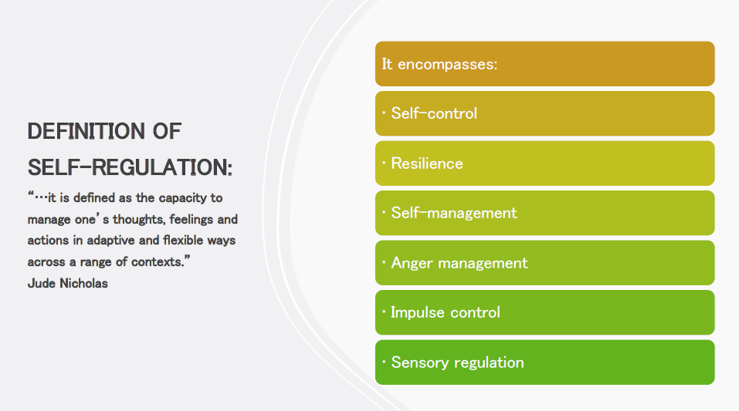

Slide 4
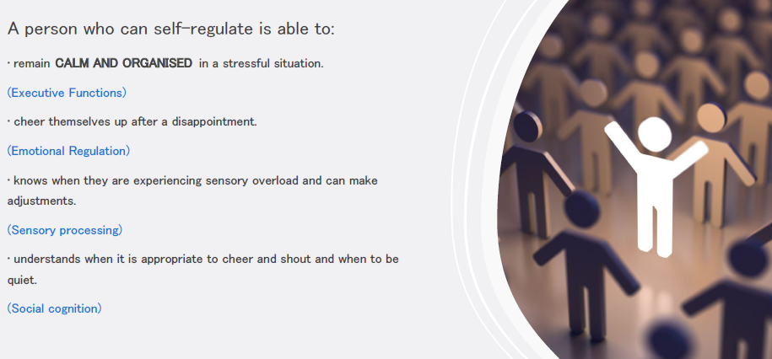

Slide 5
The Zones of Regulation aims to teach children strategies to help them cope with these feelings so they can get back to feeling calm and ready to learn.
We want to teach all of our children good coping and regulation strategies so they can help themselves when they experience anxiety and stress.
By teaching them how to cope with these feelings, we might make them better at tackling learning challenges and build better resilience so they don’t give up so easily when faced with difficulty.
Teaching the children at a young age about managing their feelings will support them in later life so that they don’t turn to negative coping strategies which affect their mental and physical wellbeing.

Slide 6
The Zones of Regulation teaches children:
Vocabulary of emotional terms
How to recognise their own emotions
How to detect the emotions of others (read others’ facial expressions)
What may trigger certain emotions
How others may see their behaviour
Problem solving skills

Slide 7
We aim to help children to:
Recognise when they are in the different Zones and learn how to change or stay in the Zone they are in.
Increase their emotional vocabulary so they can explain how they are feeling.
Recognise when other people are in different Zones, thus developing better empathy.
Develop an insight into what might make them move into the different Zones.
Understand that emotions, sensory experiences such as lack of sleep or hunger and their environment might influence which Zone they are in.
Develop problem-solving skills and resilience
Identify a range of calming and alerting strategies that support them (known as their personal ‘toolkit’.)

Slide 8
What are the different Zones?
Blue Zone: low level of arousal; not ready to learn; feels sad, sick, tired, bored, moving slowly.
Green Zone: calm state of alertness; optimal level to learn; feels happy, calm, feeling okay, focused.
Yellow Zone: heightened state of alertness; elevated emotions; has some control; feels frustrated, worried, silly/wiggly, excited, loss of some control.
Red Zone: heightened state of alertness and intense emotions; not an optimal level for learning; out of control; feels mad/angry, terrified, yelling/hitting, elated, out of control.

Slide 9
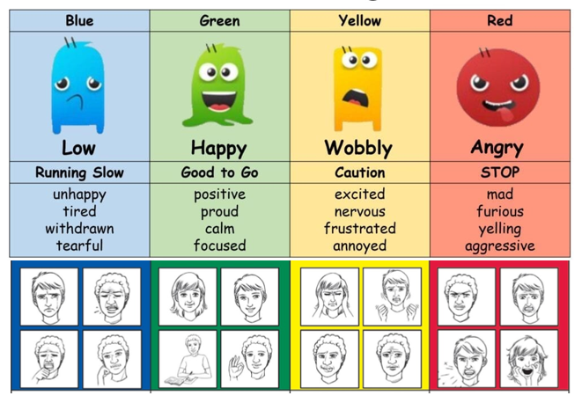
We teach the children that everyone experiences all of the Zones.
The Red and Yellow zones are not ‘bad’ or ‘naughty’ Zones.
All of the Zones are expected at one time or another.
We show them that the Blue Zone, for example, is helpful when you are trying to fall asleep.

Slide 10
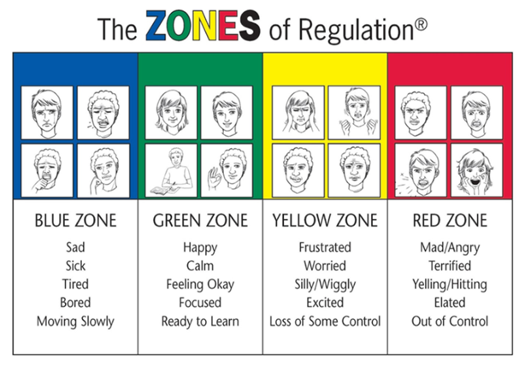
We can’t change the way children feel BUT we can help them manage their feelings/states and behaviours. “It’s ok to be angry but it not ok to hit…..”
You can be in more than one zone at a time for example sad AND angry.

Slide 11
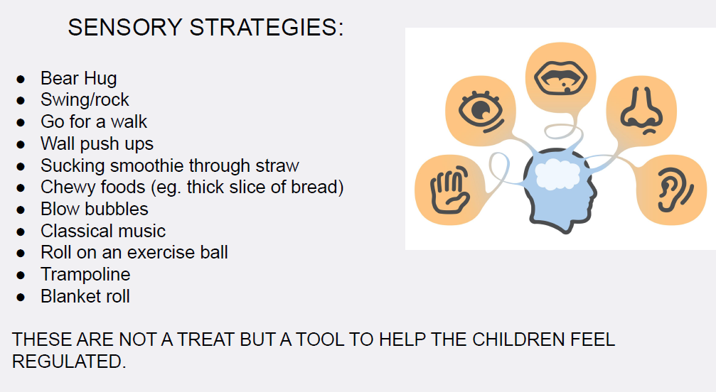

Slide 12
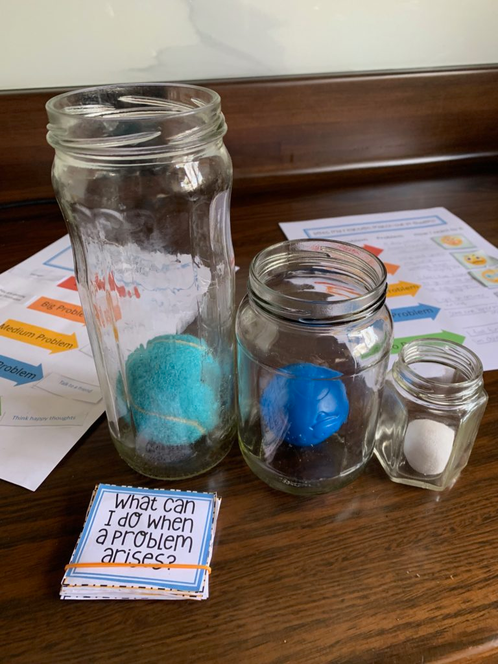
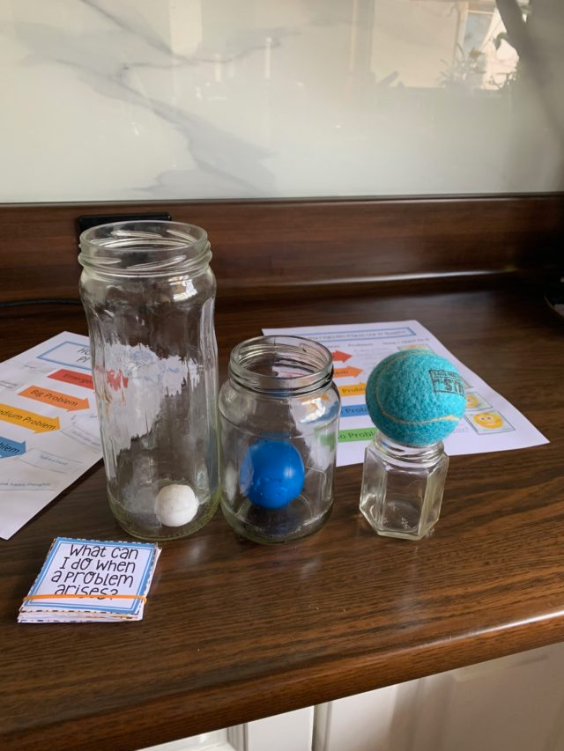
Thinking tool
This can help children evaluate how big or small problems really are.
The jars represent the problem and the balls represent the reaction. If a big problem arises, a big reaction is warranted. It fits.
They can also see what happens if the reactions don’t fit the problem.

Slide 13
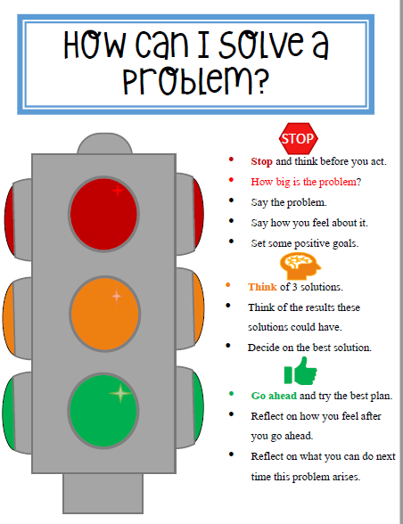

Slide 14
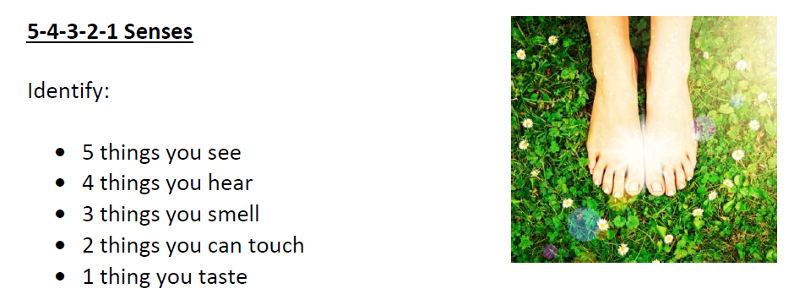
Calming techniques

Slide 15
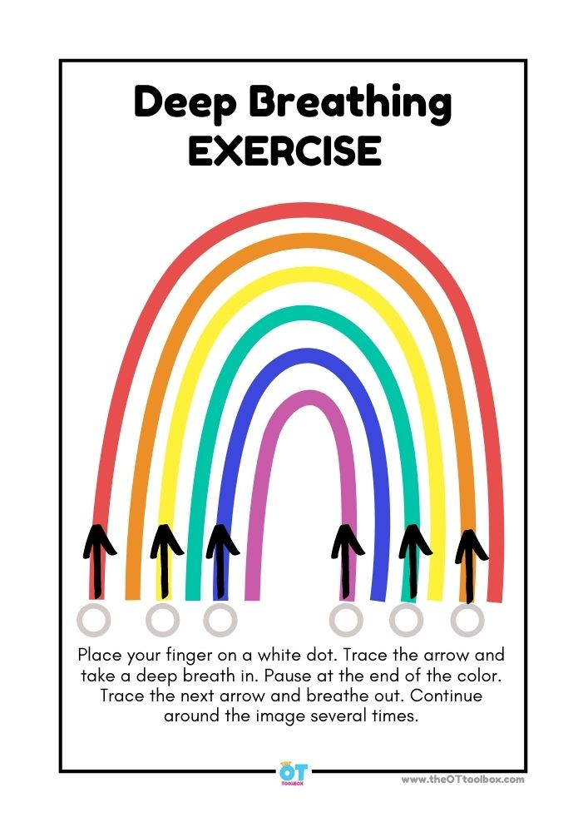
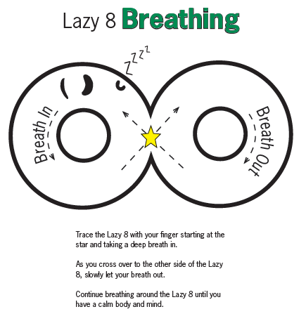

Slide 16
How can I support the Zones of Regulation?
Identify your own feelings using Zones language in front of your child. Eg “I’m frustrated, I am in the yellow zone”
Provide positive reinforcement when your child is in the Green zone and if they make efforts to stay in the Green zone. Eg “ I can see you are working really hard to stay in the Green Zone by…)
Talk about what tool you will use to be in the appropriate Zone. Eg
“ I’m going to go for a walk I need to get to the Green Zone.
Label what Zones your child may be in. Eg “ You look sleepy, are you in the blue zone?”
Create tools your child can use at home to support the Zones,

Slide 17
Common questions on the Zones of Regulation
Can my child be in more than one zone at the same time?
Yes. Your child may feel tired (blue zone) because they did not get enough sleep, and anxious (yellow zone) because they are worried about an activity at school.
Listing more than one Zone reflects a good sense of personal feelings and alertness levels.
Should children be punished for being in the RED Zone?
It’s best for children to experience the natural consequences of being in the RED zone. If a child’s actions/choices hurt someone or destroys property, they need to repair the relationship and take responsibility for the mess they create.
Once the child has calmed down, use the experience as a learning opportunity to process what the child would do differently next time.
Can you look like one Zone on the outside and feel like you are in another Zone on the inside?
Yes. Many of us “disguise” our Zone to match social expectations. We use the expression “put on a happy face” or mask the emotion so other people will have good thoughts about us. Parents often say that their children “lose it” and goes into the Red Zone as soon as they get home. This is because children are increasing their awareness of their peers and expectations when in the classroom. They make every effort to keep it together at school to stay in the Green Zone. Home is when they feel safe to let it all out.

